Slide 1
Comparison of Annual Members & Casual Riders Bike Usage
By: Kevin Ajith
Date: 13-12-2022

Slide 2

Agenda
Objective
About the data
Story from data
Recommendations
Questions

Slide 3

Objective
To analyse how casual riders are different from the annual membership holders using Cyclistic as to convert casual to annual members.

Slide 4

About the data
The data has been collected by Motivate International Inc.
The data for analysis were taken from December 2021 and November 2022.

Slide 5
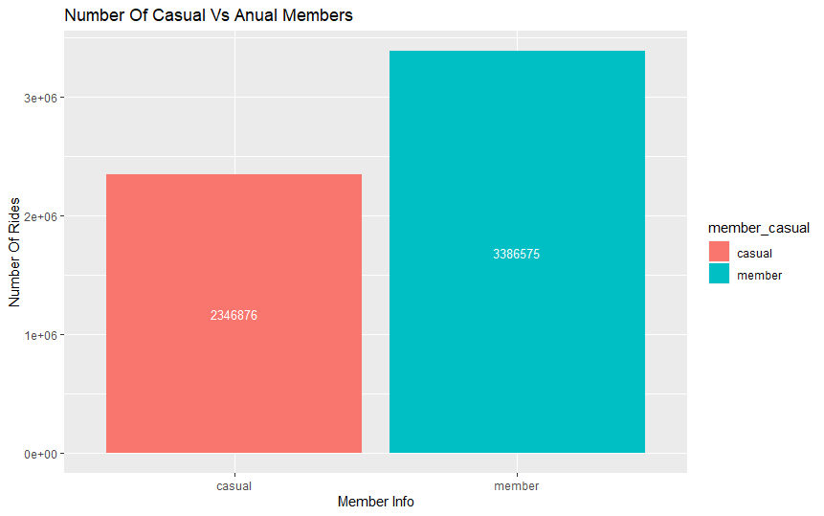
User Base
The data shows that there are significant number of casual Cyclistic ride users.
The casual members consist of 40.93% of the total user base.

Slide 6
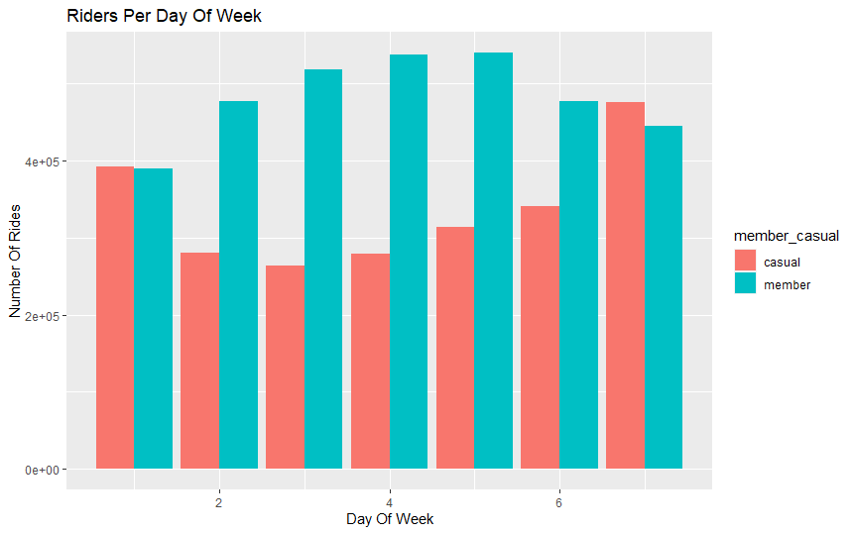
Rides per day
From the data, the casual members use Cyclistic the most on Saturdays and Sundays.
Whereas annual members use it for other days of the week.

Slide 7
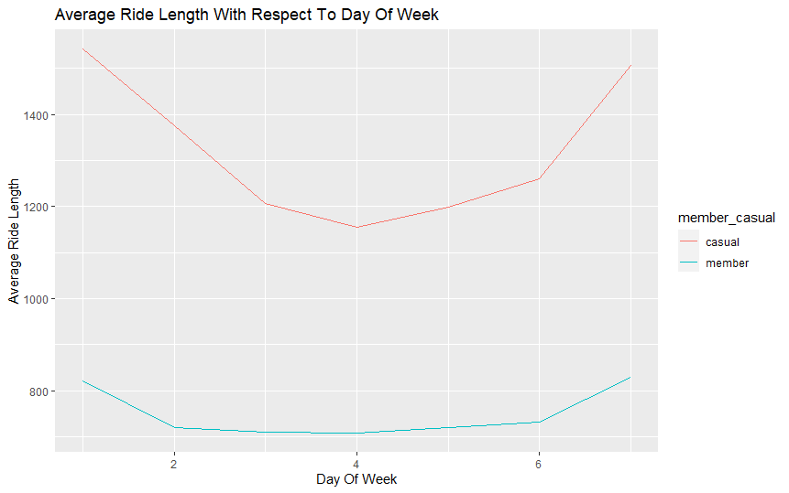
Average ride lengths
The casual users on an average take rides which are greater than 60 minutes.
Whereas the annual members take rides annual members take shorter rides in terms of time.

Slide 8
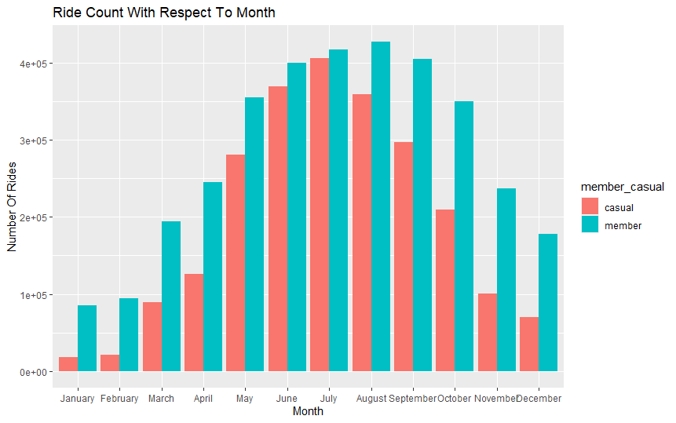
Monthly rides
The number of rides for both casual and annual members is the least during January and February.
The number of rides peaks during the months of June, July and august.
For casual members it is June and annual members it is August.

Slide 9

Recommendations
Since casual user take longer rides, Cyclistic should try to attract casual riders by launching a campaign/long distance race which people can participate to win prizes.
Giving Benefits to Annual Members on Weekend would help us to attract a lot of casual users
Launching a summertime sale would attract additional annual members as well

Slide 10

Thank You

Slide 11
Appendix
Anomalies in Data:
Inconsistent Station IDs
Start and Stop station names are missing in some cases
There are trips which have ride length of 00:00:00

Slide 12
Appendix(cont.)
The data, without any station info, was not removed because the trip could be legitimate and can skew the results.
The removal of the latitude and longitude columns were removed because of above reason and will cause inconsistencies.
The data cleaning process done are:
Data type related
Inconsistency check

Slide 13
Appendix(cont.)
Steps taken for data processing:
Calculate the length of each ride by subtracting the column “started_at” from the column “ended_at” (for example,=D2-C2) and format as HH:MM:SS.
Create a column called “day_of_week,” and calculate the day of the week that each ride started where 1 = Sunday and 7 = Saturday
Converted data for “started_at” and “ended_at” column to Date and Time Format
Removed "latitude" and "longitude", Since the data is not required for the analysis.

Slide 14
References
201912-divvy-tripdata TO 202211-divvy-tripdata from https://divvy-tripdata.s3.amazonaws.com/index.html
@Motivate International Inc. https://ride.divvybikes.com/data-license-agreement

